Slide 1


GoogLeNet

Slide 2
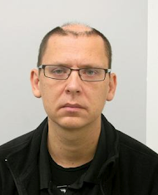
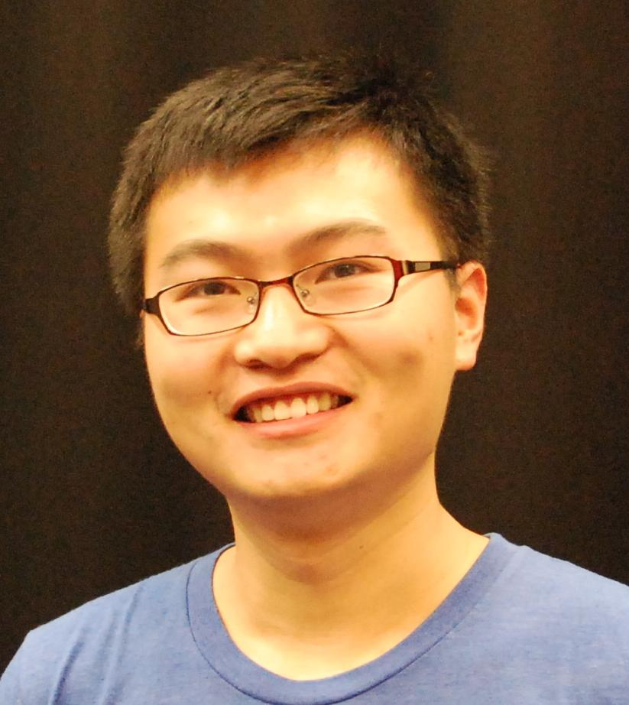
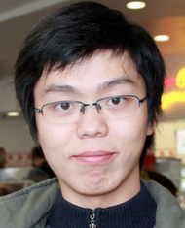

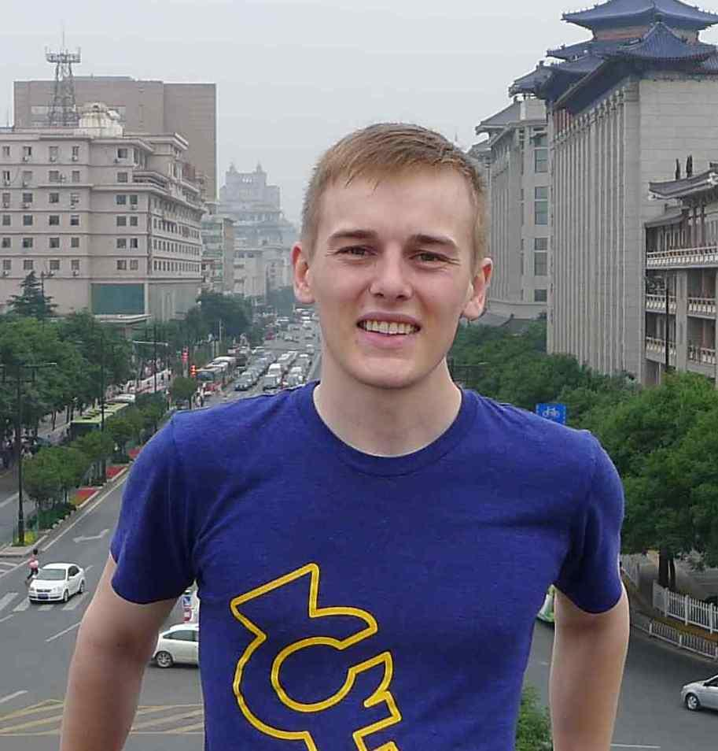
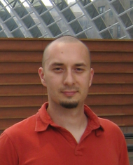
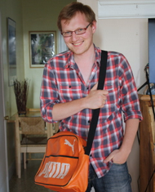
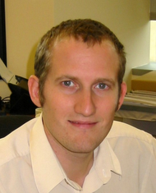
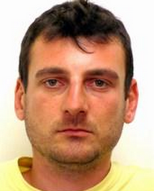
Christian
Szegedy,
Google
Wei
Liu,
UNC
Yangqing
Jia,
Google
Pierre
Sermanet,
Google
Scott
Reed,
University of Michigan
Dragomir
Anguelov,
Google
Dumitru
Erhan,
Google
Vincent
Vanhoucke,
Google
Andrew
Rabinovich,
Google

Slide 3
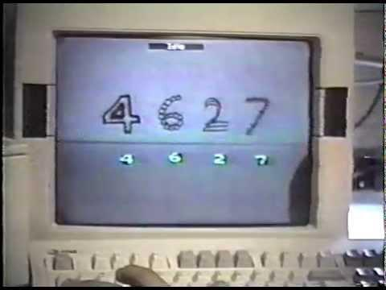
Deep Convolutional Networks
Revolutionizing computer vision since 1989
Notes:
深度学习的神经网络有几种？
1.卷积网络？
2.Deep neural nets？

Slide 4


Well…..
?

Slide 5
Deep Convolutional Networks
Revolutionizing computer vision since 1989
2012

Slide 6
Why is the deep learning revolution arriving just now?

Slide 7
Why is the deep learning revolution arriving just now?
Deep learning needs a lot of training data.

Slide 8
Why is the deep learning revolution arriving just now?
Deep learning needs a lot of training data.
Deep learning needs a lot of computational resources

Slide 9
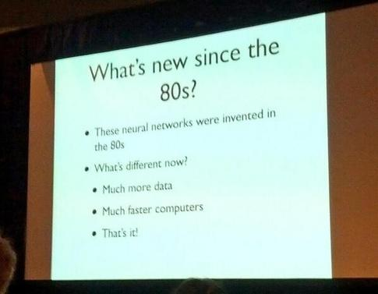
Why is the deep learning revolution arriving just now?
Deep learning needs a lot of training data.
Deep learning needs a lot of computational resources

Slide 10
Why is the deep learning revolution arriving just now?
Deep learning needs a lot of training data.
?
Deep learning needs a lot of computational resources
Notes:
算法呢？
BP：有监督细调；
无监督预训练？

Slide 11
Why is the deep learning revolution arriving just now?
Deep learning needs a lot of training data.
Szegedy, C., Toshev, A., & Erhan, D. (2013). Deep neural networks for object detection. In Advances in Neural Information Processing Systems 2013 (pp. 2553-2561).
Then state of the art performance using a training set of ~10K images for object detection on 20 classes of VOC, without pretraining on ImageNet.
Deep learning needs a lot of computational resources

Slide 12
Why is the deep learning revolution arriving just now?
Deep learning needs a lot of training data.
Agarwal, P., Girshick, R., & Malik, J. (2014). Analyzing the Performance of Multilayer Neural Networks for Object Recognition
http://arxiv.org/pdf/1407.1610v1.pdf
40% mAP on Pascal VOC 2007 only without pretraining on ImageNet.
Deep learning needs a lot of computational resources

Slide 13
Why is the deep learning revolution arriving just now?
Toshev, A., & Szegedy, C.
Deeppose: Human pose estimation via deep neural networks.
CVPR 2014
Setting the state of the art of human pose estimation on LSP by training CNN on four thousand images from scratch.
Deep learning needs a lot of training data.
Deep learning needs a lot of computational resources

Slide 14

Why is the deep learning revolution arriving just now?
Deep learning needs a lot of training data.
Deep learning needs a lot of computational resources

Slide 15
Why is the deep learning revolution arriving just now?
Deep learning needs a lot of training data.
Deep learning needs a lot of computational resources
Erhan, D., Szegedy, C., Toshev, A., & Anguelov, D.
Scalable Object Detection using Deep Neural Networks. CVPR 2014
Significantly faster to evaluate than typical (non-specialized) DPM implementation, even for a single object category.

Slide 16
Why is the deep learning revolution arriving just now?
Deep learning needs a lot of training data.
Large scale distributed multigrid solvers since the 1990ies.
MapReduce since 2004 (Jeff Dean et al.)
Scientific computing is dedicated to solving large scale complex numerical problems for decades on scale via distributed systems.
Deep learning needs a lot of computational resources

Slide 17
UFLDL (2010) on Deep Learning
“While the theoretical benefits of deep networks in terms of their compactness and expressive power have been appreciated for many decades, until recently researchers had little success training deep architectures.”
… snip …
“How can we train a deep network? One method that has seen some success is the greedy layer-wise training method.”
… snip …
“Training can either be supervised (say, with classification error as the objective function on each step), but more frequently it is unsupervised “
Andrew Ng, UFLDL tutorial
Notes:
1957 感知机 -> 1986 BP算法： 30年
1986 BP -> 2006 DL：20年
2006 DL -> 2016 ?：10年

Slide 18
Why is the deep learning revolution arriving just now?
Deep learning needs a lot of training data.
Deep learning needs a lot of computational resources
?????

Slide 19
Why is the deep learning revolution arriving just now?

Slide 20
Why is the deep learning revolution arriving just now?

Slide 21
Why is the deep learning revolution arriving just now?
Rectified Linear Unit
Glorot, X., Bordes, A., & Bengio, Y. (2011). Deep sparse rectifier networks
In Proceedings of the 14th International Conference on Artificial Intelligence and Statistics. JMLR W&CP Volume (Vol. 15, pp. 315-323).
Notes:
Rectifier = hinge activation function : max(0, x)
ANN + SVM: loss function + penalty regularization

Slide 22
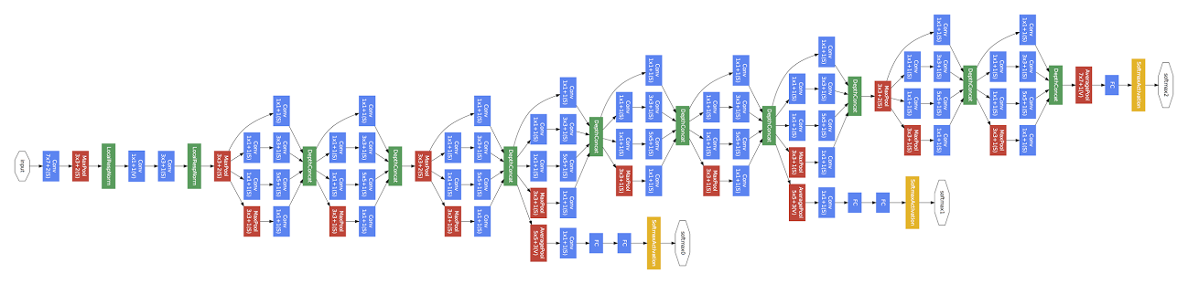
GoogLeNet
Convolution
Pooling
Softmax
Other
Notes:
Other: 秘方？

Slide 23
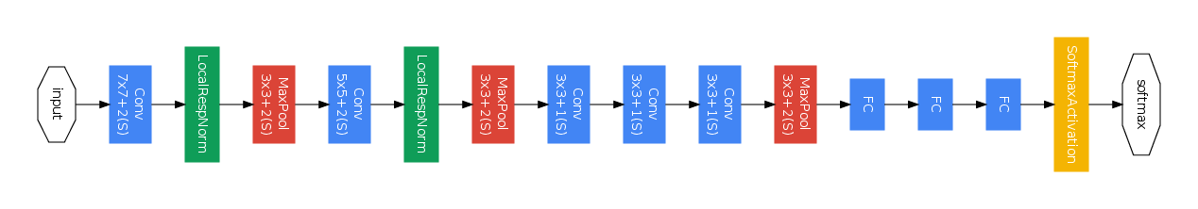
GoogLeNet vs State of the art
GoogLeNet
Convolution
Pooling
Softmax
Other
Zeiler-Fergus Architecture (1 tower)
Notes:
Multiple map features

Slide 24
Problems with training deep architectures?
Vanishing gradient?
Exploding gradient?
Tricky weight initialization?

Slide 25
Problems with training deep architectures?
Vanishing gradient?
Exploding gradient?
Tricky weight initialization?

Slide 26
Justified Questions
Why does it have so many layers???

Slide 27
Justified Questions
Why does it have so many layers???

Slide 28
Why is the deep learning revolution arriving just now?
It used to be hard and cumbersome to train deep models due to sigmoid nonlinearities.
Notes:
No，it is not all the case
But sparse representation: max(0, 1 – w’x)

Slide 29
Why is the deep learning revolution arriving just now?
It used to be hard and cumbersome to train deep models due to sigmoid nonlinearities.
Deep neural networks are highly non-convex without any obvious optimality guarantees or nice theory.
Notes:
BP网络： S型激活函数
卷积网络： 卷积、池化

Slide 30
Why is the deep learning revolution arriving just now?
It used to be hard and cumbersome to train deep models due to sigmoid nonlinearities.
ReLU
Deep neural networks are highly non-convex without any optimality guarantees or nice theory.
?
Notes:
SVM 和 ANN 的关系又近了一步： hinge loss = rectifier activation

Slide 31
Theoretical breakthroughs
Arora, S., Bhaskara, A., Ge, R., & Ma, T. Provable bounds for learning some deep representations.
ICML 2014

Slide 32
Theoretical breakthroughs
Arora, S., Bhaskara, A., Ge, R., & Ma, T. Provable bounds for learning some deep representations.
ICML 2014
Even non-convex ones!

Slide 33
Hebbian Principle
Input
Notes:
David Hebb (1904 – 1985) <The organization of behaviors>, 1949

Slide 34
Cluster according activation statistics
Layer 1
Input

Slide 35
Cluster according correlation statistics
Layer 2
Layer 1
Input

Slide 36
Cluster according correlation statistics
Layer 3
Layer 2
Layer 1
Input

Slide 37
In images, correlations tend to be local (Convolution NN)

Slide 38
Cover very local clusters by 1x1 convolutions
number of filters
1x1

Slide 39
Less spread out correlations
number of filters
1x1

Slide 40
Cover more spread out clusters by 3x3 convolutions
number of filters
1x1
3x3

Slide 41
Cover more spread out clusters by 5x5 convolutions
number of filters
1x1
3x3

Slide 42
Cover more spread out clusters by 5x5 convolutions
number of filters
1x1
5x5
3x3

Slide 43
A heterogeneous set of convolutions
number of filters
1x1
3x3
5x5

Slide 44
Schematic view (naive version)
number of filters
1x1
Filter concatenation
3x3
1x1 convolutions
3x3 convolutions
5x5 convolutions
5x5
Previous layer
Notes:
Wide convolution: uni- bi- tri- … gram
Multiple feature map

Slide 45
Naive idea
Filter concatenation
1x1 convolutions
3x3 convolutions
5x5 convolutions
Previous layer

Slide 46
Naive idea (does not work!)
Filter concatenation
1x1 convolutions
3x3 convolutions
5x5 convolutions
3x3 max pooling
Previous layer

Slide 47
Inception module
Filter concatenation
3x3 convolutions
5x5 convolutions
1x1 convolutions
1x1 convolutions
1x1 convolutions
1x1 convolutions
3x3 max pooling
Previous layer
Notes:
Why, how? What’s the meaning?

Slide 48
Inception
Why does it have so many layers???
Convolution
Pooling
Softmax
Other

Slide 49
Inception
Convolution
Pooling
Softmax
Other
9 Inception modules
Network in a network in a network...

Slide 50
1024
Inception
832
832
512
512
512
256
480
480
Width of inception modules ranges from 256 filters (in early modules) to 1024 in top inception modules.

Slide 51
1024
Inception
832
832
512
512
512
256
480
480
Width of inception modules ranges from 256 filters (in early modules) to 1024 in top inception modules.
Can remove fully connected layers on top completely
Notes:
Depth + Width: 又粗又长

Slide 52
1024
Inception
832
832
512
512
512
256
480
480
Width of inception modules ranges from 256 filters (in early modules) to 1024 in top inception modules.
Can remove fully connected layers on top completely
Number of parameters is reduced to 5 million

Slide 53
1024
Inception
832
832
512
512
512
256
480
480
Width of inception modules ranges from 256 filters (in early modules) to 1024 in top inception modules.
Can remove fully connected layers on top completely
Number of parameters is reduced to 5 million
Computional cost is increased by less than 2X compared to Krizhevsky’s network. (<1.5Bn operations/evaluation)
Notes:
Nine layers (<Nine Chapters>)

Slide 54
Classification results on ImageNet 2012
Number of Models | Number of Crops | Computational Cost | Top-5 Error | Compared to Base
1 | 1 (center crop) | 1x | 10.07% | -
1 | 10* | 10x | 9.15% | -0.92%
1 | 144 (Our approach) | 144x | 7.89% | -2.18%
7 | 1 (center crop) | 7x | 8.09% | -1.98%
7 | 10* | 70x | 7.62% | -2.45%
7 | 144 (Our approach) | 1008x | 6.67% | -3.41%
*Cropping by [Krizhevsky et al 2014]

Slide 55
Classification results on ImageNet 2012
Number of Models | Number of Crops | Computational Cost | Top-5 Error | Compared to Base
1 | 1 (center crop) | 1x | 10.07% | -
1 | 10* | 10x | 9.15% | -0.92%
1 | 144 (Our approach) | 144x | 7.89% | -2.18%
7 | 1 (center crop) | 7x | 8.09% | -1.98%
7 | 10* | 70x | 7.62% | -2.45%
7 | 144 (Our approach) | 1008x | 6.67% | -3.41%
6.54%
*Cropping by [Krizhevsky et al 2014]

Slide 56
Classification results on ImageNet 2012
Team | Year | Place | Error (top-5) | Uses external data
SuperVision | 2012 | - | 16.4% | no
SuperVision | 2012 | 1st | 15.3% | ImageNet 22k
Clarifai | 2013 | - | 11.7% | no
Clarifai | 2013 | 1st | 11.2% | ImageNet 22k
MSRA | 2014 | 3rd | 7.35% | no
VGG | 2014 | 2nd | 7.32% | no
GoogLeNet | 2014 | 1st | 6.67% | no

Slide 57
Detection
Girshick, R., Donahue, J., Darrell, T., & Malik, J. (2013). Rich feature hierarchies for accurate object detection and semantic segmentation. arXiv preprint arXiv:1311.2524.

Slide 58
Detection
Girshick, R., Donahue, J., Darrell, T., & Malik, J. (2013). Rich feature hierarchies for accurate object detection and semantic segmentation. arXiv preprint arXiv:1311.2524.
Improved proposal generation:
Increase size of super-pixels by 2X
coverage 92% 90%
number of proposals: 2000/image 1000/image

Slide 59
Detection
Girshick, R., Donahue, J., Darrell, T., & Malik, J. (2013). Rich feature hierarchies for accurate object detection and semantic segmentation. arXiv preprint arXiv:1311.2524.
Improved proposal generation:
Increase size of super-pixels by 2X
coverage 92% 90%
number of proposals: 2000/image 1000/image
Add multibox* proposals
coverage 90% 93%
number of proposals: 1000/image 1200/image
*Erhan, D., Szegedy, C., Toshev, A., & Anguelov, D.
Scalable Object Detection using Deep Neural Networks.
CVPR 2014

Slide 60
Detection
Girshick, R., Donahue, J., Darrell, T., & Malik, J. (2013). Rich feature hierarchies for accurate object detection and semantic segmentation. arXiv preprint arXiv:1311.2524.
Improved proposal generation:
Increase size of super-pixels by 2X
coverage 92% 90%
number of proposals: 2000/image 1000/image
Add multibox* proposals
coverage 90% 93%
number of proposals: 1000/image 1200/image
Improves mAP by about 1% for single model.
*Erhan, D., Szegedy, C., Toshev, A., & Anguelov, D.
Scalable Object Detection using Deep Neural Networks.
CVPR 2014

Slide 61
Detection results without ensembling
Team | mAP | external data | contextual model | bounding-box regression
Trimps-Soushen | 31.6% | ILSVRC12 Classification | no | ?
Berkeley Vision | 34.5% | ILSVRC12 Classification | no | yes
UvA-Euvision | 35.4% | ILSVRC12 Classification | ? | ?
CUHK DeepID-Net2 | 37.7% | ILSVRC12 Classification+ Localization | no | ?
GoogLeNet | 38.0% | ILSVRC12 Classification | no | no
Deep Insight | 40.2% | ILSVRC12 Classification | yes | yes

Slide 62
Final Detection Results
Team | Year | Place | mAP | external data | ensemble | contextual model | approach
UvA-Euvision | 2013 | 1st | 22.6% | none | ? | yes | Fisher vectors
Deep Insight | 2014 | 3rd | 40.5% | ILSVRC12 Classification + Localization | 3 models | yes | ConvNet
CUHK DeepID-Net | 2014 | 2nd | 40.7% | ILSVRC12 Classification + Localization | ? | no | ConvNet
GoogLeNet | 2014 | 1st | 43.9% | ILSVRC12 Classification | 6 models | no | ConvNet

Slide 63
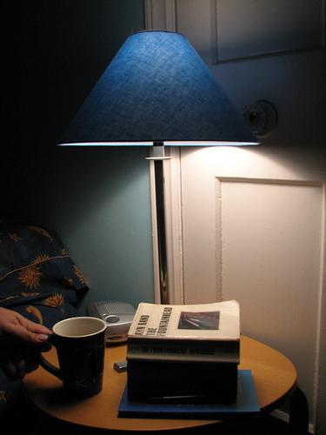
Classification failure cases
Groundtruth: ????

Slide 64
Classification failure cases
Groundtruth: coffee mug

Slide 65
Classification failure cases
Groundtruth: coffee mug
GoogLeNet:
table lamp
lamp shade
printer
projector
desktop computer

Slide 66
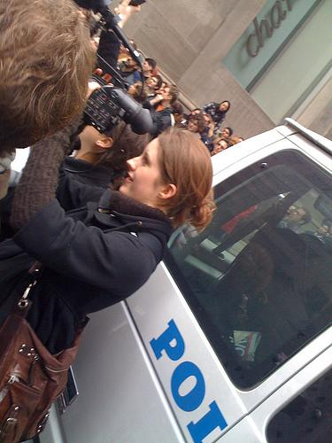
Classification failure cases
Groundtruth: ???

Slide 67
Classification failure cases
Groundtruth: Police car

Slide 68
Classification failure cases
Groundtruth: Police car
GoogLeNet:
laptop
hair drier
binocular
ATM machine
seat belt

Slide 69
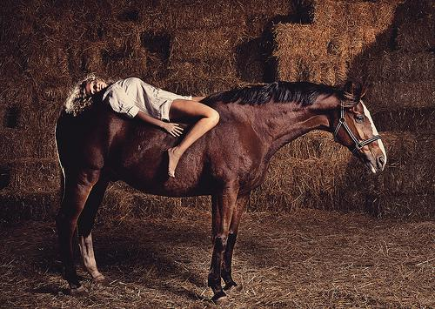
Classification failure cases
Groundtruth: ???

Slide 70
Classification failure cases
Groundtruth: hay

Slide 71
Classification failure cases
Groundtruth: hay
GoogLeNet:
sorrel (horse)
hartebeest
Arabian camel
warthog
gaselle

Slide 72
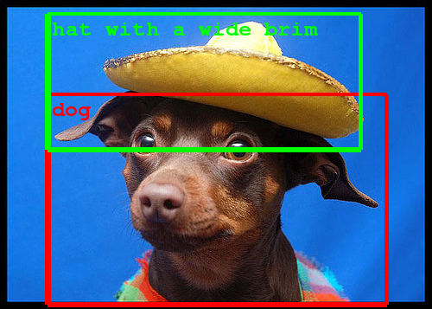
Acknowledgments
We would like to thank:
Chuck Rosenberg, Hartwig Adam, Alex Toshev, Tom Duerig, Ning Ye, Rajat Monga, Jon Shlens, Alex Krizhevsky, Sudheendra Vijayanarasimhan, Jeff Dean, Ilya Sutskever, Andrea Frome
… and check out our poster!

